Slide 1
Diabetes Prediction Using Machine Learning
Internship Project at
Exposys Data Labs
Presented by: Sakshee Yande

Slide 2
Why Predict Diabetes?
Diabetes is a chronic disease affecting millions worldwide.
Highlights the global prevalence and impact of diabetes on various age groups.
Early prediction can help manage or prevent severe complications.
Emphasizes the importance of early detection in improving health outcomes and reducing risks.
GOAL: Develop a model to predict diabetes with high accuracy.
Establishes the aim to create a reliable machine learning model for diabetes prediction.

Slide 3
Dataset Overview
Dataset: Pima Indians Diabetes Dataset
The dataset is specifically designed for diabetes prediction and is widely used for machine learning tasks.
Records: 768 samples, 8 features
A manageable dataset size, with sufficient features to train and evaluate a model effectively.
Features: Glucose, Blood Pressure, BMI, etc.
These features represent critical health metrics closely related to diabetes.
Target: Diabetes outcome (1 = Positive, 0 = Negative)
Binary classification target: whether a person has diabetes or not.

Slide 4
Data Preprocessing
Handling Missing Values:
Identified and replaced missing or zero values in critical features (e.g., Glucose, Blood Pressure) with the mean of the respective column.
Normalization:
Scaled numerical features to a standard range using standard scaling (mean = 0, standard deviation = 1). This step ensures uniformity and optimizes model performance.
Data Splitting:
Divided the dataset into training and testing sets:
Training Set: 80% of the data used to train the model.
Testing Set: 20% of the data used for evaluating the model's performance.

Slide 5
Machine Learning Model
Algorithm: Random Forest Classifier Selected for its robustness and ability to handle classification problems effectively. Reason for Selection: Capable of dealing with non-linear relationships in the data. Provides feature importance, which helps in identifying the most significant predictors of diabetes. | Implementation Steps: Initialized a Random Forest Classifier with default parameters for simplicity. Trained the model using the processed training dataset. Tuned hyper-parameters to optimize model performance. Key Advantages of Random Forest: High accuracy due to ensemble learning. Reduces the risk of overfitting by averaging predictions.

Slide 6
Evaluation Metrics
Accuracy: Achieved a high accuracy score, indicating the model's effectiveness in predicting diabetes correctly.
Precision, Recall, and F1-Score:
Precision: Proportion of correctly predicted positive observations out of total predicted positives.
Recall (Sensitivity): Proportion of actual positives identified correctly by the model.
F1-Score: Harmonic mean of precision and recall, balancing the trade-off between them.
Confusion Matrix:
True Positives (TP) True Negatives (TN) False Positives (FP) False Negatives (FN)

Slide 7
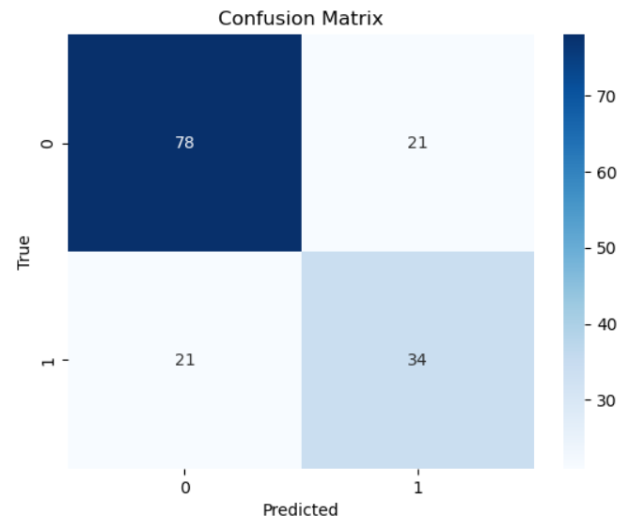
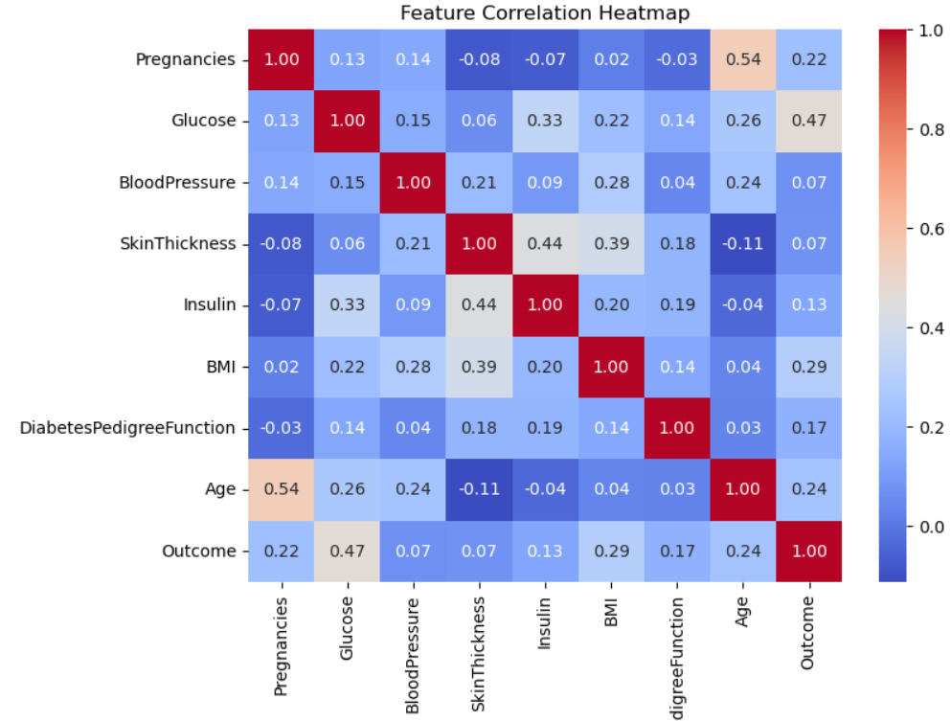
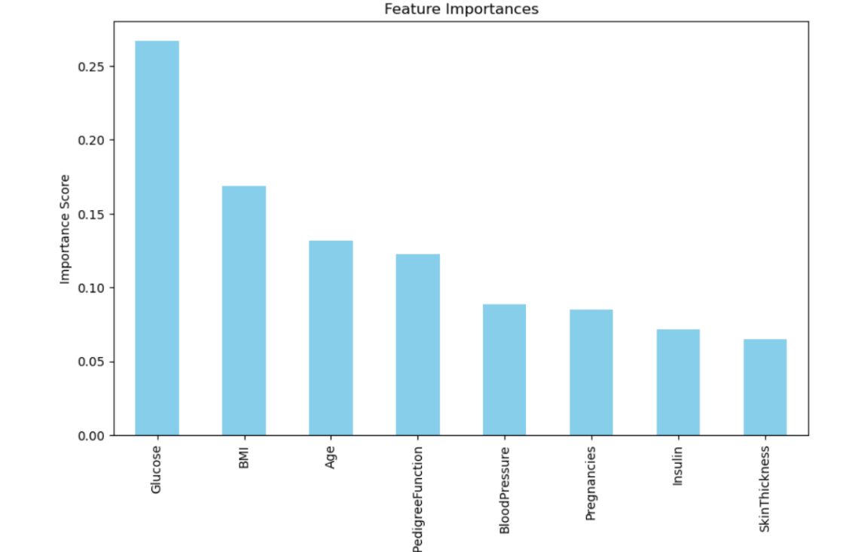
Insights Through Visualizations

Slide 8
Conclusion and Future Work
Conclusion:
Achieved High Accuracy: The model successfully predicts diabetes with a high degree of accuracy, helping to distinguish between diabetic and non-diabetic individuals.
Early Prediction: Early identification of potential diabetes cases can allow for lifestyle changes, timely interventions, and improved health management.
Model Reliability: The Random Forest Classifier provided strong performance due to its ability to handle complex data and avoid overfitting.
Future Work:
Explore Other Algorithms: Experiment with other machine learning algorithms like Support Vector Machines (SVM), Gradient Boosting, or Neural Networks to compare results.
Enhance Data Preprocessing: Consider more advanced techniques for handling missing data, outliers, and imbalanced classes to improve model performance.
Real-world Deployment: Investigate the potential for integrating the model into healthcare systems for real-time diabetes prediction.

Slide 9
References
Dataset:
Pima Indians Diabetes Dataset Source: Kaggle/UCI Machine Learning Repository This dataset is widely used for diabetes prediction tasks and has been extensively researched in machine learning literature.
Libraries and Tools Used: Pandas, NumPy, Matplotlib/Seaborn, Scikit-learn, Jupyter Notebook.
Programming Language:
Python: The primary language used for implementing the project and building the model.

Slide 10
THANK YOU !

